Slide 1
ARM® AMBA® APB Advanced Peripheral Bus
AMBA-APB

Slide 2
Topics
• Overview of APB
• APB architecture and features
• Signal descriptions
• Transfers
• Operating States
AMBA-APB

Slide 3
Overview of APB
AMBA-APB

Slide 4
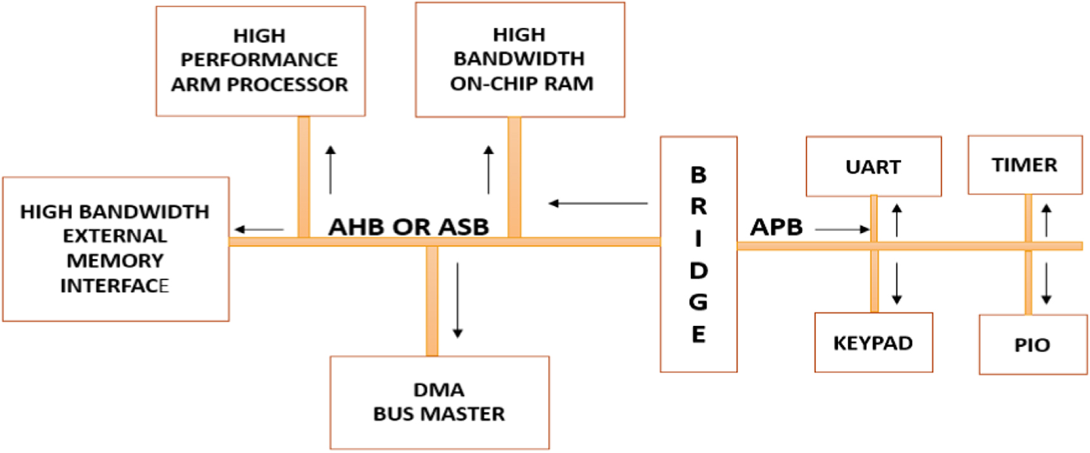
Low Frequency devices
High Frequency devices
AMBA-APB

Slide 5
APB Protocol Overview
The Advanced Peripheral Bus (APB) is a simple, low-power protocol within ARM’s AMBA architecture, designed for interfacing low-bandwidth peripheral devices
Architecture
Master: Initiates and controls data transfers.
Slave: Peripheral device responding to master commands.
Address Bus: Carries the target peripheral address.
Data Bus: Transfers data between master and slave.
Control Signals: Manage data flow (e.g., PSEL, PWRITE, PENABLE).
Operating States
Idle: No transaction occurs.
Setup: Address and control signals are established.
Enable: Data transfer is active until PREADY is asserted.
Completion: Transaction ends, returning to idle.
Transfer Process
Setup Phase: The master sets up the address and control signals (PADDR, PSEL, PWRITE).
Enable Phase: PENABLE is asserted to start data transfer. The master waits for PREADY from the slave.
Completion: Data is written (PWDATA) or read (PRDATA), and the bus returns to idle.
AMBA-APB

Slide 6
Architecture
AMBA-APB

Slide 7
1. Master
The Master initiates all data transfers on the APB. It controls the address, data, and control signals to communicate with the peripheral devices. Typically, the master could be a processor or a bridge from a more complex bus like AHB or AXI.
Responsibilities:
Sending address and control signals
Initiating read or write operations
Waiting for the PREADY signal from slaves
3. Data Bus
The Data Bus transfers information between the master and slaves.
PWDATA (Write Data): Data sent from the master to the slave.
PRDATA (Read Data): Data sent from the slave to the master.
2. Slaves
Slaves are the peripheral devices that respond to the master’s commands. These can be various low-bandwidth devices such as timers, UARTs, GPIOs, or SPI controllers.
Responsibilities:
Listening to the master’s address and control signals
Providing data (PRDATA) during read operations or accepting data (PWDATA) during write operations
Asserting PREADY when ready to complete the transaction
4. Control Signals
Control signals manage the communication flow between the master and slaves:
PSEL (Peripheral Select): Activates the targeted slave.
PENABLE: Indicates the data transfer phase.
PWRITE: Specifies the type of operation (1 for write, 0 for read).
PREADY: Signals that the slave is ready for the transaction.
PSLVERR: Indicates an error during a transaction, if any.
AMBA-APB

Slide 8
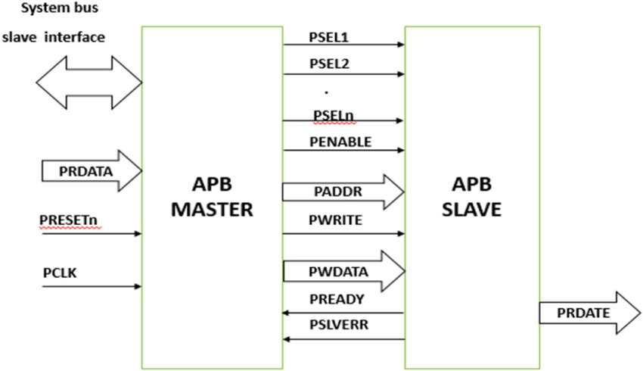
5. Address Bus
The Address Bus (PADDR) carries the address from the master to the slave, indicating which peripheral register the master wants to access.
6. Clock and Reset Signals
PCLK (Peripheral Clock): Synchronous clock driving the protocol.
PRESETn (Peripheral Reset): Active-low reset signal that initializes peripherals.
AMBA-APB

Slide 9
Key Features of APB Protocol
Low Power Consumption:
Suitable for battery-operated devices or subsystems where power efficiency is critical.
Simplicity:
The protocol is straightforward, reducing complexity and facilitating easy integration of peripherals.
Non-Pipelined Transfers:
Only one transfer occurs at a time, minimizing design overhead.
Single Clock Domain:
Operates in a single clock domain, avoiding complexities related to clock domain crossing.
Low Bandwidth:
Primarily designed for peripherals that don't require high data rates.
Supports Both Read and Write Operations:
Read and write transactions are performed sequentially.
Slave-Specific Selection:
Uses PSELx to target specific peripherals in the system.
Error Signaling:
The PSLVERR signal enables detection of invalid operations or unsupported transactions.
Integration with AMBA Architecture:
Often part of a hierarchical bus architecture, connected to high-performance buses like AXI or AHB through a bridge.
Flexible Address Space:
Supports a wide range of peripheral address spaces, making it scalable for different designs.
AMBA-APB

Slide 10
Signal descriptions
AMBA-APB

Slide 11
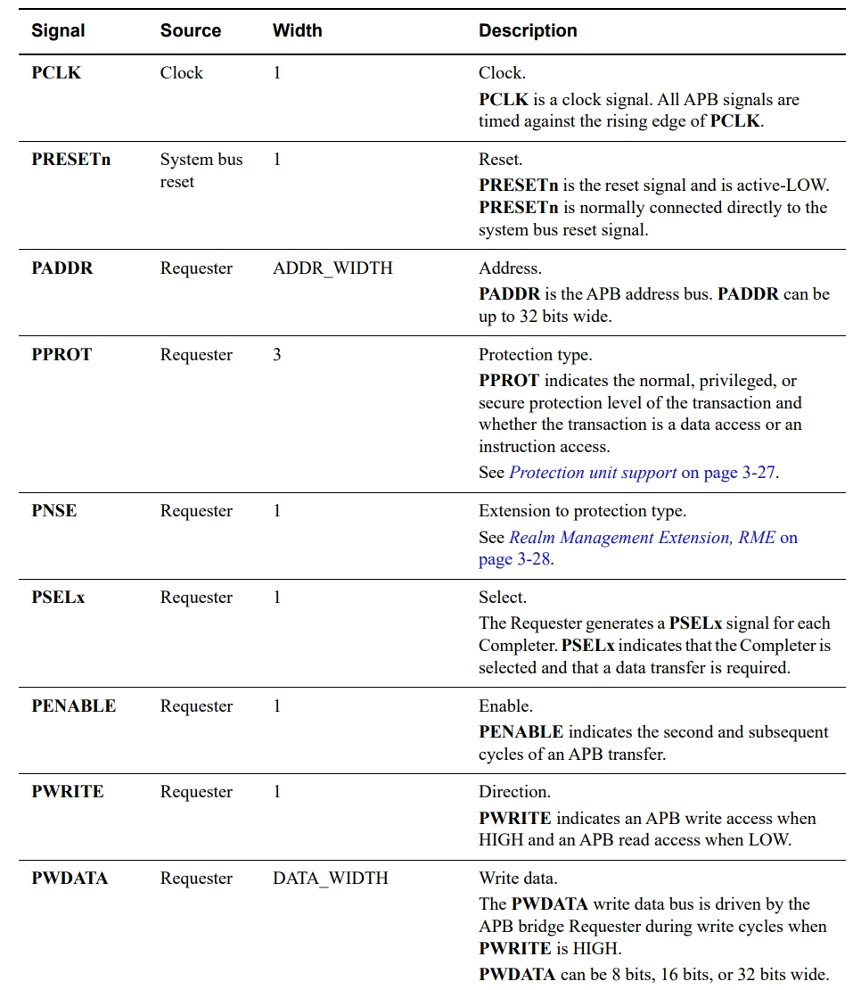
AMBA-APB

Slide 12
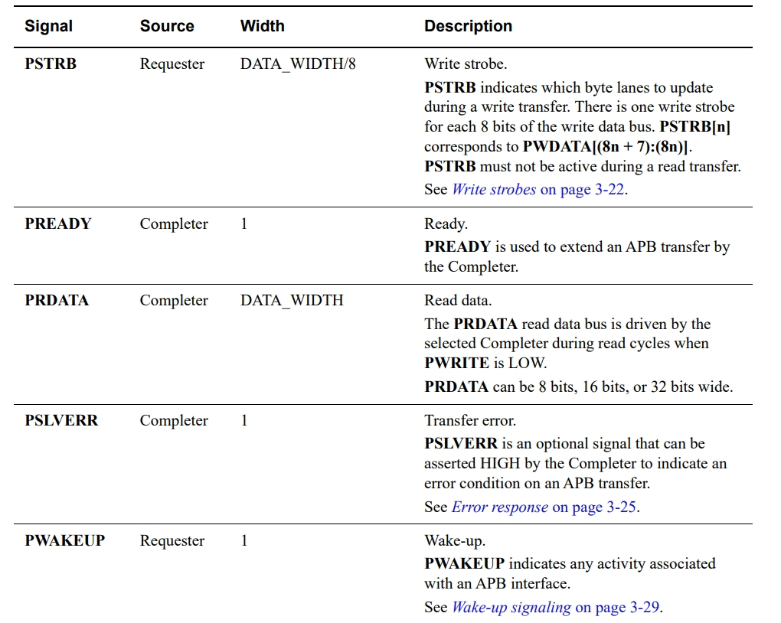
AMBA-APB

Slide 13
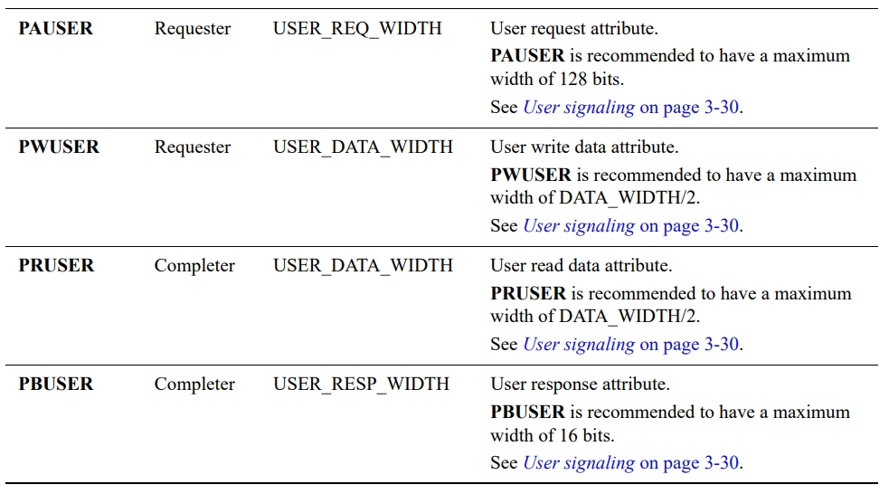
Address bus
An APB interface has a single address bus, PADDR, for read and write transfers. PADDR indicates a byte address.
PADDR is permitted to be unaligned with respect to the data width, but the result is UNPREDICTABLE. For example, a Completer might use the unaligned address, aligned address, or signal an error response
Data buses
The APB protocol has two independent data buses, PRDATA for read data and PWDATA for write data,. The buses can be 8 bits, 16 bits, or 32 bits wide. The read and write data buses must have the same width.
Data transfers cannot occur concurrently because the read data and write data buses do not have their own individual handshake signals.
AMBA-APB

Slide 14
Transfers
AMBA-APB

Slide 15
Write transfers
This section describes the following types of write transfer:
• With no wait states
• With wait states
All signals shown in this section are sampled at the rising edge of PCLK.
With no wait states
1. Idle Phase (T0 - T1):
Duration: From clock cycle T0 to T1.
During this phase:
The bus is in an idle state, meaning no active transaction is taking place.
Signals like PSEL and PENABLE are deasserted (low).
The bus is ready for the next transaction to be initiated by the master.
2. Setup Phase (T1 - T2):
Duration: From clock cycle T1 to T2.
During this phase:
The master asserts the PSEL signal, selecting the target slave.
The PADDR signal is driven with the address of the peripheral or memory location where the data needs to be written.
The PWRITE signal is set to 1, indicating that this is a write transfer.
The PWDATA signal starts driving the data to be written, but it won't be captured until the access phase.
The PENABLE signal remains low, indicating the transaction is still in the setup phase.
AMBA-APB

Slide 16
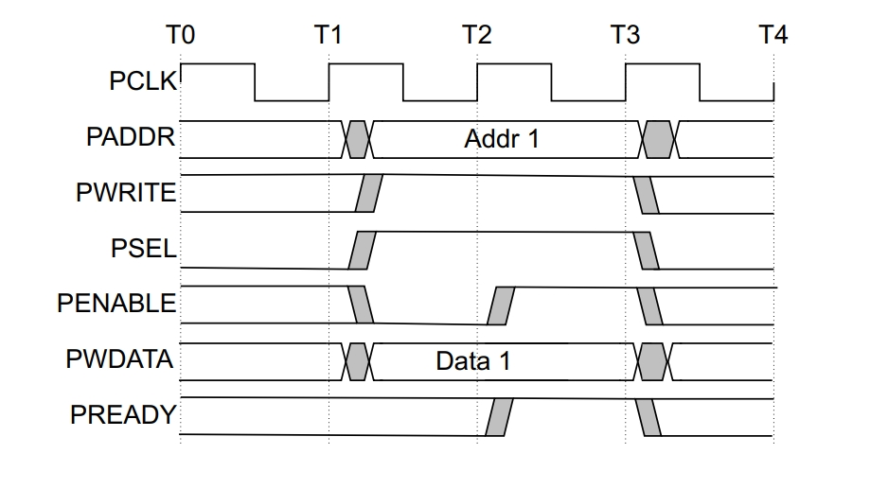
3. Access Phase (T2 - T3):
Duration: From clock cycle T2 to T3.
During this phase:
The master asserts the PENABLE signal, marking the start of the access phase.
The slave reads the address and control signals provided during the setup phase and latches the data from the PWDATA signal.
The PREADY signal is high throughout the access phase, indicating that the slave is ready to complete the transfer. Since there are no wait states, the transaction completes within this cycle.
Key Signals:
PENABLE = 1: Indicates the transfer is active.
PWDATA: Contains the data (Data 1) to be written to the target peripheral.
PREADY = 1: Indicates the slave is ready to accept the data.
AMBA-APB

Slide 17
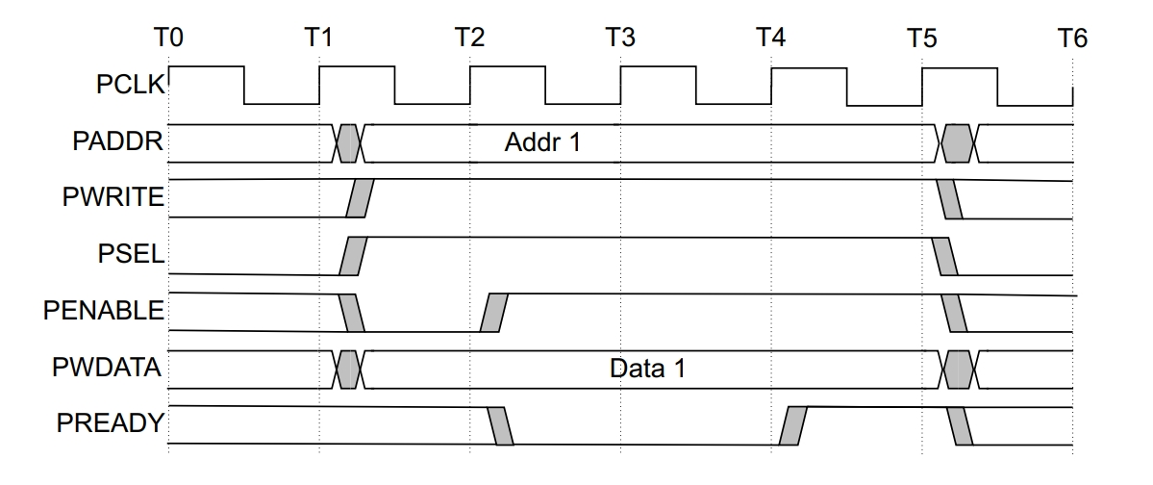
With wait states
1. Idle Phase (T0 - T1):
Duration: From clock cycle T0 to T1.
During this phase:
The bus is in an idle state, meaning no active transaction is taking place.
Signals like PSEL and PENABLE are deasserted (low).
The bus is ready for the next transaction to be initiated by the master.
2. Setup Phase (T1 - T2):
Duration: From clock cycle T1 to T2.
During this phase:
The master asserts the PSEL signal, selecting the target slave.
The PADDR signal is driven with the address of the peripheral or memory location where the data needs to be written.
The PWRITE signal is set to 1, indicating that this is a write transfer.
The PWDATA signal starts driving the data to be written, but it won't be captured until the access phase.
The PENABLE signal remains low, indicating the transaction is still in the setup phase.
AMBA-APB

Slide 18
3. Access Phase with Wait States (T2 - T4):
Duration: From clock cycle T2 to T4 (or longer if more wait states are introduced).
During this phase:
At T2, the master asserts the PENABLE signal to begin the data transfer.
The slave checks the transaction request and provides the PREADY signal:
PREADY = 0: Indicates the slave is not ready to complete the transfer. This introduces a wait state, and the transaction remains in the access phase until the slave asserts PREADY = 1.
The PWDATA signal remains stable during wait states.
At T4, the PREADY signal transitions to 1, indicating the slave is ready to accept the data, completing the transfer.
Key Signals:
PENABLE = 1: Indicates that the transfer is active.
PWDATA: Contains the data to be written.
PREADY: Low during wait states, transitioning to high when the slave is ready.
Key Differences from No Wait State Transfer
In a no-wait transfer, PREADY = 1 immediately in the Access Phase, and the transaction completes in a single clock cycle.
In a wait-state transfer, PREADY = 0 introduces one or more clock cycles of delay, extending the Access Phase.
AMBA-APB

Slide 19
Read transfers
Two types of read transfer are described in this section:
• With no wait states
• With wait states
All signals shown in this section are sampled at the rising edge of PCLK.
With no wait states
1. Idle Phase (T0 - T1):
Duration: From clock cycle T0 to T1.
During this phase:
The bus is in an idle state, and no transaction is active.
Key signals like PSEL and PENABLE are deasserted (low).
The bus is ready to initiate a new transaction.
2. Setup Phase (T1 - T2):
Duration: From clock cycle T1 to T2.
During this phase:
The master asserts the PSEL signal, selecting the target slave for communication.
The PADDR signal is driven with the address of the location to be read.
The PWRITE signal is set to 0, indicating a read operation.
PENABLE remains deasserted (low), signaling that the setup phase is ongoing.
The PRDATA signal is not yet valid as data transfer has not started.
AMBA-APB

Slide 20
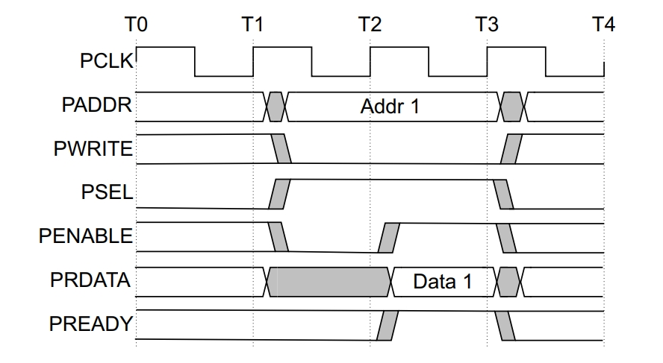
3. Access Phase (T2 - T3):
Duration: From clock cycle T2 to T3.
During this phase:
The master asserts the PENABLE signal to begin the actual data transfer.
The slave responds to the address and control signals provided during the setup phase and drives the data to the PRDATA line.
The PREADY signal is high throughout this phase, indicating that the slave is ready to complete the transfer immediately (no wait states).
At the rising edge of T3, the master latches the data (Data 1) from the PRDATA line.
Key Signals:
PENABLE = 1: Indicates that the read transfer is active.
PRDATA: Contains the valid data being read from the slave.
PREADY = 1: Confirms that the slave is ready for data transfer.
AMBA-APB

Slide 21
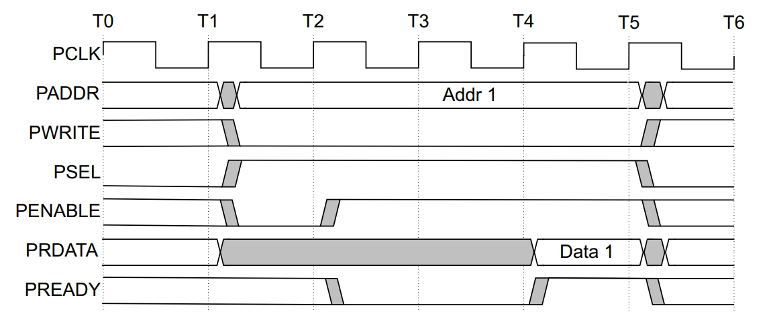
With wait states
1. Idle Phase (T0 - T1):
Duration: From clock cycle T0 to T1.
During this phase:
The bus is idle, and no active transaction is taking place.
Signals like PSEL and PENABLE are deasserted (low).
The bus is ready to initiate a new transaction.
2. Setup Phase (T1 - T2):
Duration: From clock cycle T1 to T2.
During this phase:
The master asserts the PSEL signal, selecting the target slave.
The PADDR signal is driven with the address of the peripheral or memory location where the data needs to be written.
The PWRITE signal is set to 0, indicating that this is a read transfer.
The PRDATA signal remains invalid as the slave has not yet started the transfer.
The PENABLE signal remains low, indicating the transaction is still in the setup phase.
AMBA-APB

Slide 22
3. Access Phase with Wait States (T2 - T4):
Duration: From clock cycle T2 to T4 (or longer if more wait states are introduced).
During this phase:
At T2, the master asserts the PENABLE signal to begin the data transfer.
The slave checks the transaction request and provides the PREADY signal:
PREADY = 0: Indicates the slave is not ready to complete the transfer. This introduces a wait state, and the transaction remains in the access phase until the slave asserts PREADY = 1.
The PRDATA signal remains stable during wait states.
At T4, the PREADY signal transitions to 1, indicating the slave is ready to accept the data, completing the transfer.
Key Signals:
PENABLE = 1: Indicates that the transfer is active.
PRDATA: Becomes valid only when PREADY = 1.
PREADY: Low during wait states, transitioning to high when the slave is ready.
Key Differences from No Wait State Transfer
In a read transfer with no wait state, PREADY = 1 immediately in the Access Phase, and the transaction completes in a single clock cycle.
In a read transfer with wait state, PREADY = 0 introduces one or more clock cycles of delay, extending the Access Phase until the slave is ready to provide valid data.
AMBA-APB

Slide 23
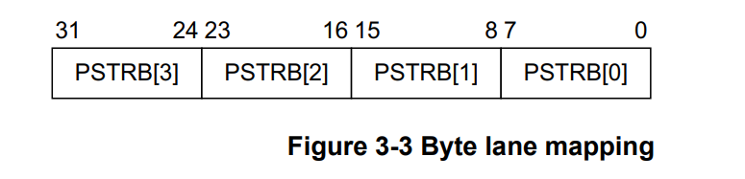
WHAT IS PSTRB?
It provides sparse data transfer during write transfer.
For Read transfer, Requester has to drive all bits low in PSTRB.
AMBA-APB

Slide 24
Slave Error
Slave Error is only considered valid during the last cycle of the transfer.
Error condition can be generated in both write and read operation.
It is recommended, that PSLVERR is driven LOW when PREADY, PENABLE , PSEL is driven LOW.
MAPPING APB SLVERR with Other Interface
From AXI to APB :- PSLVERR mapped with RRESP for read and BRESP for writes.
From AHB to APB :- PSLERR mapped with HRESP for both read and write.
AMBA-APB

Slide 25
Operating States
AMBA-APB

Slide 26
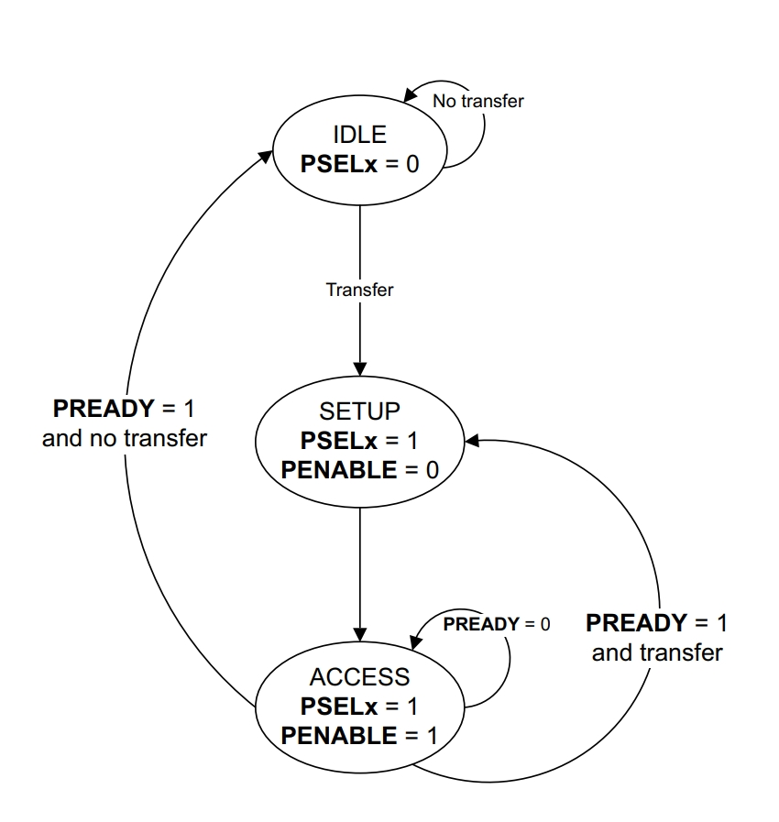
AMBA-APB

Slide 27
1. IDLE State
Condition:
PSELx = 0
Operation:
This state indicates that no transfer is currently happening.
The bus remains in the IDLE state when the PREADY signal is 1 and there is no ongoing transfer request.
It is the default state when no activity occurs on the bus.
2. SETUP Phase
Condition:
PSELx = 1, PENABLE = 0
Operation:
This phase prepares the transfer by enabling the PSELx signal for the target peripheral.
In this state, the necessary control and address signals are set up to begin the transfer.
The transition occurs from IDLE to SETUP when a transfer request is initiated.
3. ACCESS Phase
Condition:
PSELx = 1, PENABLE = 1
Operation:
In this phase, data transfer takes place between the master and the slave.
If PREADY = 1, the transfer is complete, and the system may return to the IDLE state or stay in the ACCESS phase for further transfers.
If PREADY = 0, the system stays in the ACCESS phase, waiting for the slave to signal readiness.
VLSI EXPERT

Slide 28
Thank You
AMBA-APB

